Slide 1
QURE
A doctor consultation website
By: Team-2

Slide 2
Agenda
Overview
Tools & Technologies
Flow Diagram
Class Diagram
Use-Case
Sequence Diagram
Limitations
Demo

Slide 3
Overview
Patient registration, make an appointment online
Doctor accept / reject an appointment.
Admin can delete a doctor and can manage the pharmacy
Internationalization: support multiple languages
User friendly UI
Spring Boot:
▪ Ease to maintenance
▪ Reduce code redundancy
▪ High extension

Slide 4
Tools & Technologies
Spring Boot
MongoDB
Angular
Git / GitHub
STS

Slide 5
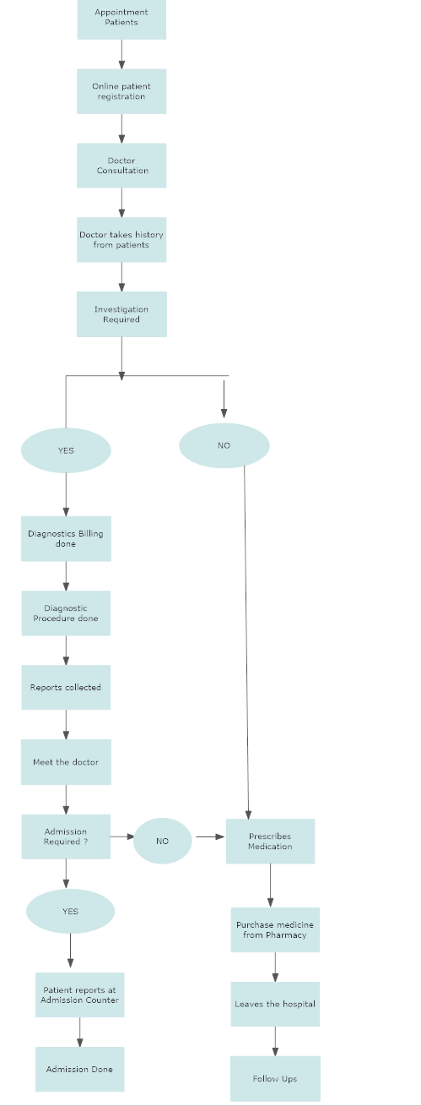

Slide 6
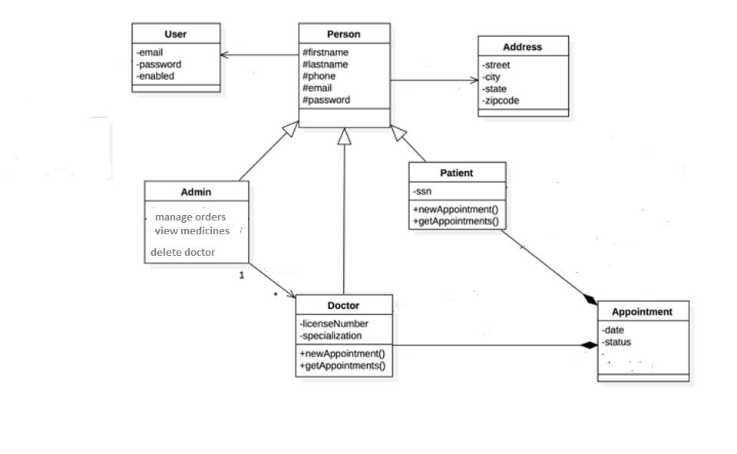
Class Diagram

Slide 7
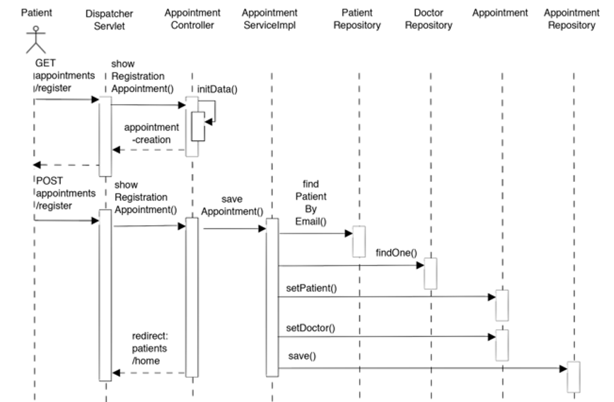
Appointment Sequence Diagram

Slide 8
Use-Cases
Patient
‣ Registration online
‣ Book / Cancel an appointment
‣ Order medicine
‣ Chat with doctor
Doctor
‣ Doctor can cancel appointment
‣ Chat with patient
Admin
‣ Delete doctor’s record
‣ Manage the pharmacy with medicines and orders

Slide 9
Limitations
Payment function is not supported right now
Tracking of order could be there

Slide 10
THANK YOU

